Slide 1










CareerMatch
Close the Gap Between
CareerMatch
Match your resume to any job and get a personalized learning roadmap.
62%
Junior Data Scientist
Resume and Job
match
Instant resume and job description analysis in the browser
Your Resume
Job Description
Upload your resume
Paste the job description
What You’ll Get
Weighted skill-matching algorithm distinguishing required vs. preferred skills
Paste job description here...
Match score and gap analysis
Drag and drop your file here or click to browse
Missing skills, prioritized
Personalized study plan
Personalized study timelines tailored to weekly availability
PDF or DOCX
Based on your weekly availability
Analyze Match
100% private, client-side execution with no server storage

Slide 2



















The Problem & The Solution
Bridging the gap between resumes and real job expectations
THE PROBLEM
THE SOLUTION
Generic feedback.
No clear next step.
CareerMatch turns gaps
into a clear learning roadmap.
RESUME
RESUME
Generic career advice leaves
students guessing what to learn next
Transforms text and photo resumes into structured learning pathways
CareerMatch
Standard tools stop at rejection scores
Structured learning
pathway
FEEDBACK
Automatic prerequisite ordering ensures foundational skills
come first
(e.g., Python before Machine Learning)
“Gain more
experience.”
Python
Feedback is vague and
rarely actionable
Data Analysis
62/100
Machine Learning
Advanced ML
Over 35
built-in skill definitions with
dependency trees underpin the analysis

Slide 3





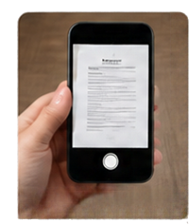



















How It Works
Three simple steps from resume to learning roadmap
2
Upload
Analysis
Roadmap
Upload a photo of your resume or paste resume text along with a job description.
Get an instant match score with matched skills and missing competencies.
Follow a prerequisite-aware learning timeline tailored to your weekly study hours.
Paste Resume
Matched Skills
Python Fundamentals
Match Score
78
Data Analysis
/100
Missing Competencies
Machine Learning
Job description
Advanced ML
Study hours per week
20
hours
Tailor your roadmap to the time you can commit each week.
2 hours
40 hours

Slide 4





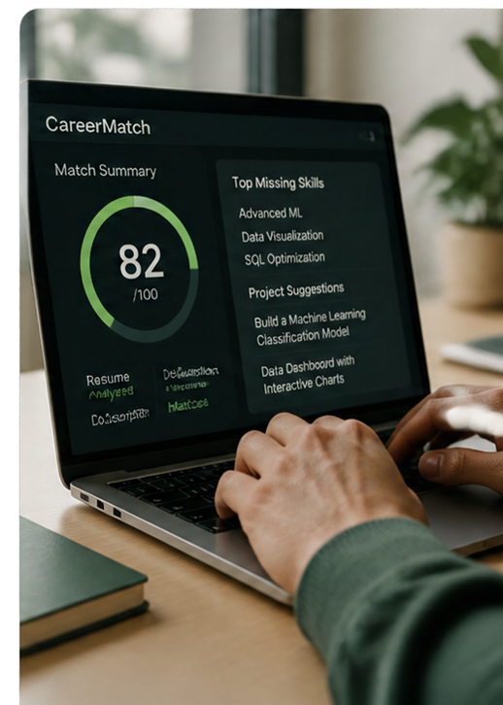

Key Features & Privacy by Design
Advanced functionality. Built for trust.
Privacy by Design
Weighted Match
Client-side OCR
Projects
That Fit
Zero server-side storage keeps your resume and data on your device.
Our matching algorithm prioritizes mandatory requirements over preferred ones.
Extracts text from resumes using Tesseract.js, entirely in your browser.
Get tailored portfolio project ideas for every missing skill.
100%
browser-executed architecture
ensures no external data transfer

Slide 5















Portfolio Projects & Capstones
Turn skill gaps into real projects and stronger resumes
CAPSTONE PROJECT
Customer Churn Prediction Pipeline
Every missing skill is paired with
a targeted, hands-on project
End-to-end machine learning solution to predict customer churn and identify key drivers.
Python
SQL
Machine Learning
Capstone projects combine multiple
competencies in one GitHub repository
Data Ingestion
Python
Data Analysis
SQL
Model Training
Machine Learning
Evaluation & Insights
Python
Sample Resume Bullet
Generates ready-to-use resume
bullet points with measurable outcomes
"Built a churn prediction model in Python using machine learning, improving prediction accuracy by 18% on test data."
Supports university career centers with concrete, actionable guidance

